Slide 1
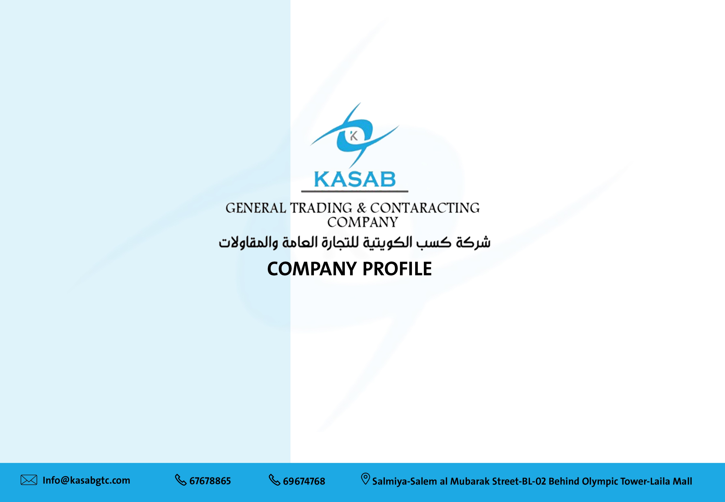

Slide 2


ABOUT KASAB:
Kasab Kuwaiti General Trading & Contracting is a Kuwaiti company specialist in construction known as KASAB.
KASAB is a company Specialized in general contracting and electro-mechanical works and professional managing of construction services.
KASAB offers the-highest international standard of technical and commercial solutions on turnkey projects and Electro mechanical works as well as providing the typical level of coordination and Quality via the different activities.
KASAB has been established and working in the Kuwait market since 2008 with total paid capital 500,000 Kuwaiti dinar.

Slide 3

MISSION
VISION
KASAB is not only a construction company but also a very Intensive team striving to bring growth and trust to ours. Community, helping to maintain techno commercially support our clients to achieve their goals and comply their targets.
KASAB mission it to perform for its customers the highest level of quality construction services at fair and competitive market prices. To ensure the longevity of our company through repeat and referral business achieved by customer satisfaction in all areas including timeliness, attention to detail and service minded attitudes.
To maintain the highest levels of professionalism, integrity, honesty and fairness in our relationships with our suppliers, subcontractors, professional associates and customers. To achieve our clients their goals and comply their targets.
CO-FOUNDER &CEO MESSAGE
We are pleased to present full information that will provide awareness of our company and its business capability. As an esteemed organization works at the field of construction and electromechanical Works. We have the honor to provide our potential services at architecture, civil and Electro-mechanical techno commercial aspects on turnkey basis. In link with sending that message to our customers and client, we would like to take the opportunity to state our co-operation and to maintain your trust within Kasab Kuwaiti General Trading & Contracting Company.
Co - Founder & CEO
Eng. AKSHAN EL-AGAMY

Slide 4
CONCEPT
KEY ORGANIZATION
KASAB concept has been stated on integrity and respect. That means holding the highest level of standards and codes of international ethical culture. For being competitive, KASAB keeps every satisfaction melting with client. Customer requirements with in the proposed budget estimation and time schedule frame lines. KASAB recognize market techno-commercial aspects and its strength variation and changes so that we always inset to upgrade our technique and set up our strategic plan so far to achieve aspects.
KASAB believes that selection of the key responsible professional engineers shall
Be a typical way of stable and continuous success
A. ARCHITECTS DEPARTMENT
B. CIVIL DEPARTMENT
C. HVAC DEPARTMENT
D. PLUMBING DEPARTMENT
E. ELECTRICAL DEPARTMENT

Slide 5
TRUSTABILITY
PROJECT MANAGEMENT
KASAB computer modeling ln the design phases can identify and reduce long-term operation costs. By calculating life-cycle-costs for Manpower, equipment and materials.
This modeling identifies highest-cost operations, maintenance and repairs, and provides an opportunity to reduce long-term operating costs with the fact of project quality management latest rules and considerations.
KASAB computer modeling ln the design phases can identify and reduce long-term operation costs. By calculating life-cycle-costs for Manpower, equipment and materials.
This modeling identifies highest-cost operations, maintenance and repairs, and provides an opportunity to reduce long-term operating costs with the fact of project quality management latest rules and considerations.

Slide 6
Field of activities
CHAIN BUSINESS POLICY
- Governmental buildings
- Hospitals
- Factories and warehouses
- Power & sub stations.
- Pipelines.
- Residential projects (villas & towers )
- Commercial malls and complex
KASAB's technical staff works with your team to advance your procurement strategies. Your best interests are our top priority. We carefully match our experience to your project's demands and use our increased market visibility and-equipment financing solutions to your benefit.
KASAB offers
1- Technical and professional Experience
2- Typical manufacturer relationships
3- Highest standardized process and quality
4- Optimize Initial and total costs.

Slide 7
Field of activities
CHAIN BUSINESS POLICY
TEAM WORK
VISION
Clients that best achieve their goals. Lasting relationships are the source of our business.
KASAB support the client to feel that our staff is even more committed to the effort to properly achieve its target.
KASAB believes that, Construction is the means no the end. For us, exceptional construction is not the goal but just another medium in which we could achieve our goal – the improvement of the quality of life. Construction is but another way in which we could partake in taking life to greater heights.
By providing incomparable constrution experience and structures we were able to community as well as help the country solve unem-ployment, the economy to grow, give the workers a sense of achievement and success, and most importantly give the nation something to be proud of.
provide man shelter, sanctuary, and sense of security. Construction does not just provide shelters and structures but also jobs and opportunities for the local.
KASAB construction project is a well-coordinated and collaboration between diverse specialists. We carefully coordinate every step of the process with client, architect, engineers, subcontractors, material suppliers, municipal authorities and other team members. We take sole responsibility for overall management of the construction process, freeing you to concentrate on your business.in our relationships with our suppliers, subcontractors, professional associates and customers. To achieve our clients their goals and comply their targets.

Slide 8


Field of activities
CHAIN BUSINESS POLICY
SUBSIDIARIES
Al-Masaha Engineering Consulting Office is one of the most well-known engineering offices in Kuwait, as it is one of the offices that seeks to provide a diverse and integrated package of services specialized in engineering works and designs. AL-Masaha was established in 2017 and participated in enhancing and create many diffirent projects up to date.
Pondera, a specialize design studio powered by Al-Masaha Engineering Consulting was established in 2023 which specialized in the 2d & 3d designs for high end finish and fit out works

Slide 9
Field of activities
CHAIN BUSINESS POLICY
PROJECTS LIST
1/2

Slide 10
Field of activities
CHAIN BUSINESS POLICY
PROJECTS LIST
2/2

Slide 11
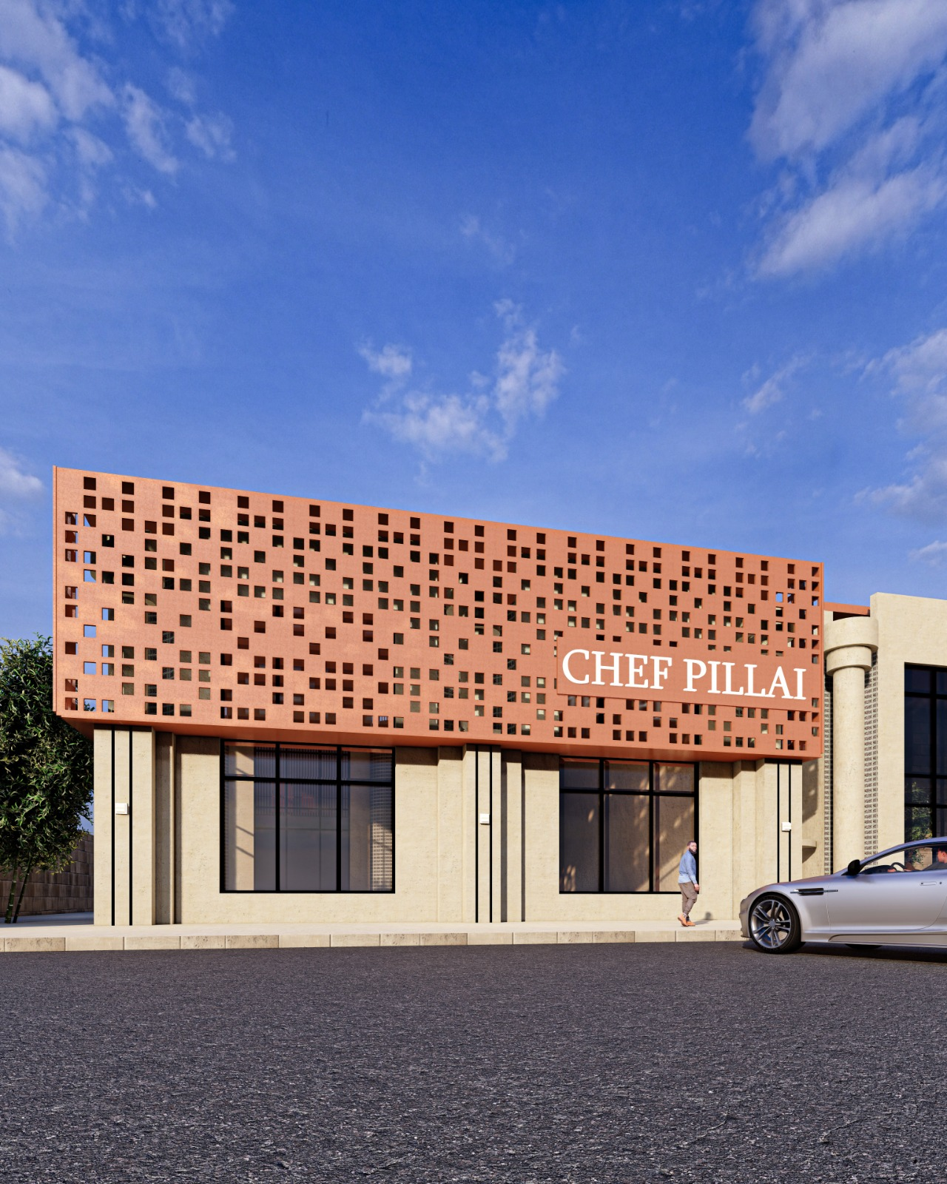
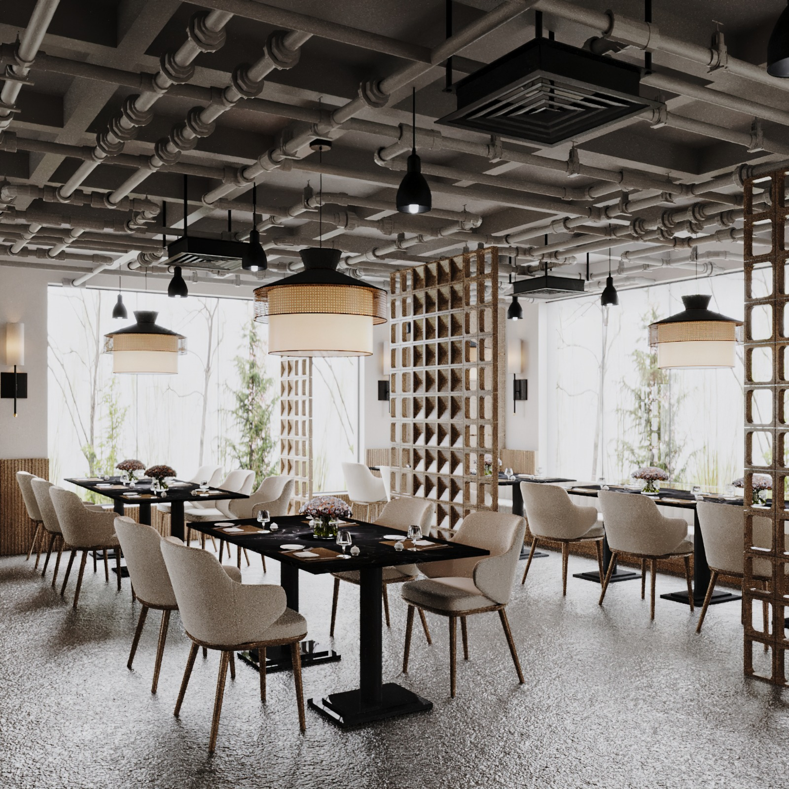

PROJECTS
Field of activities
CHAIN BUSINESS POLICY
Project Name: Fit Out Works For Chief Pili Restaurant at Abo Hlifa
Attach Photo here
Location: Abu Helifa
Contrct Value: 62,000 KD
Location: Abu Helifa
Contract Duration: 3 months
2/2

Slide 12

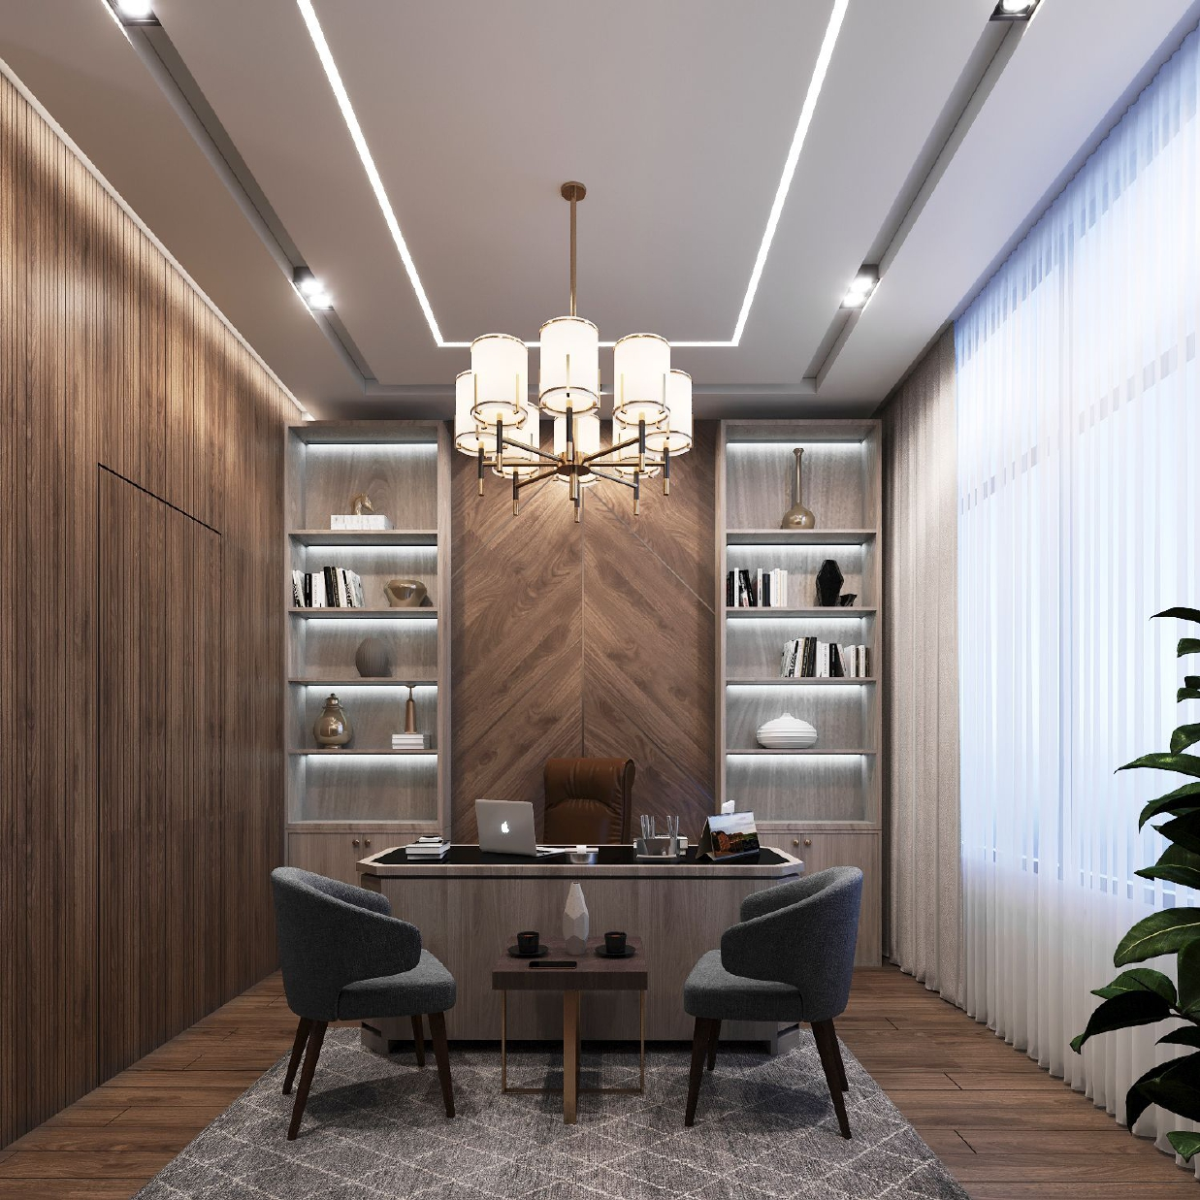
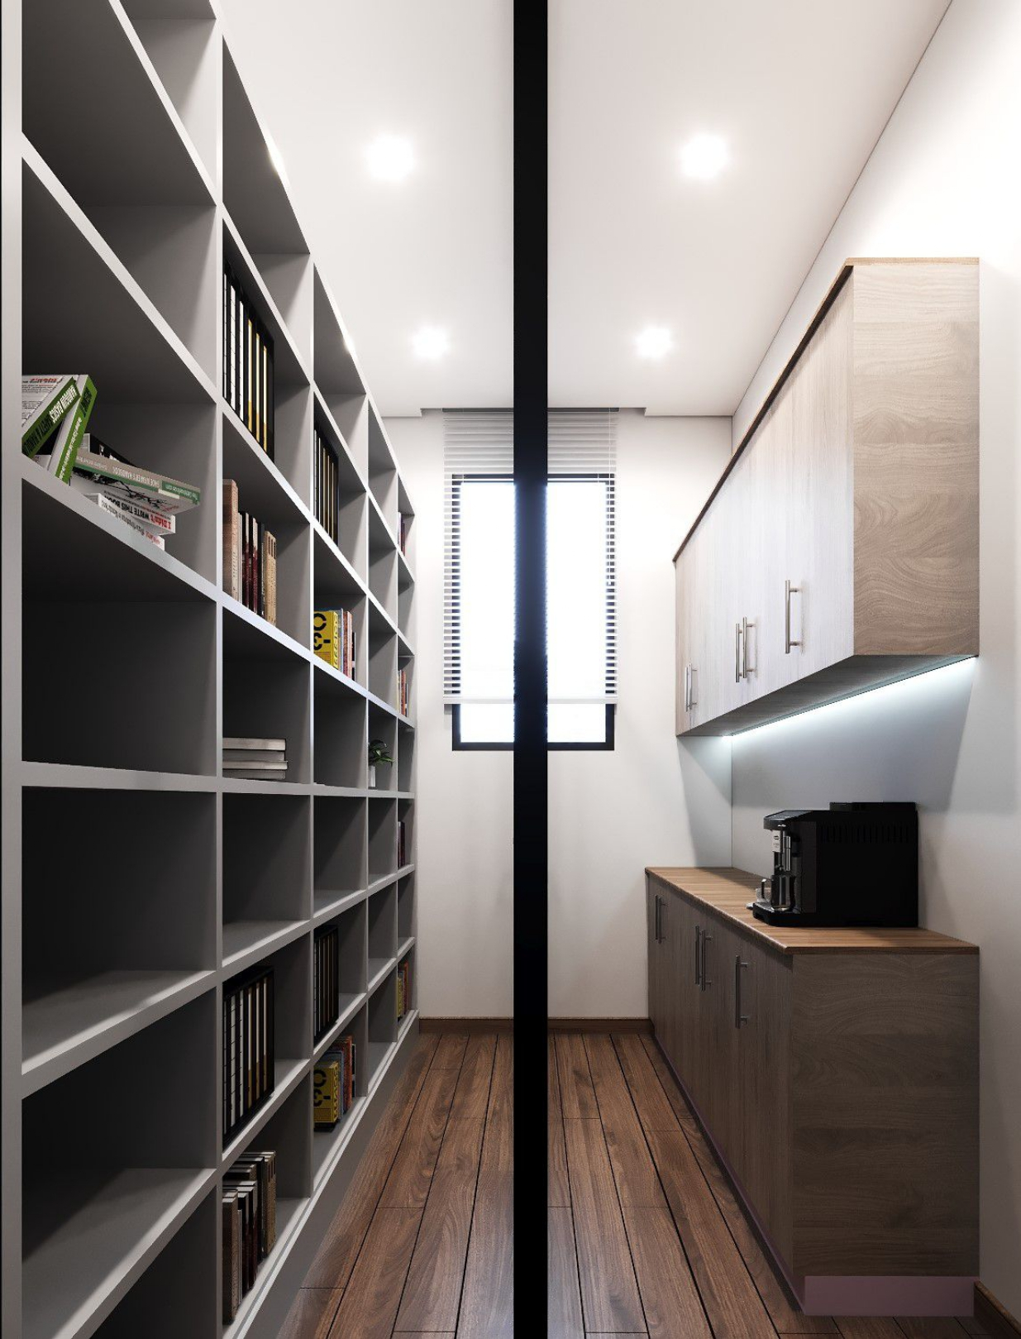
PROJECTS
Field of activities
CHAIN BUSINESS POLICY
Project Name: Fit Out Works For adminstration office office(Ahmad AL-Otaiby)
Location: Al-Manghaf
Contrct Value: 12.000KD
Contract Duration: 1 month
Attach Photo here
2/2

Slide 13
PROJECTS
Field of activities
CHAIN BUSINESS POLICY
Project Name : Skelton works Workmanship For 14 villa at Haya villas Project
Location:
Contrct Value: KD
Contract Duration:
Attach Photo here
2/2

Slide 14
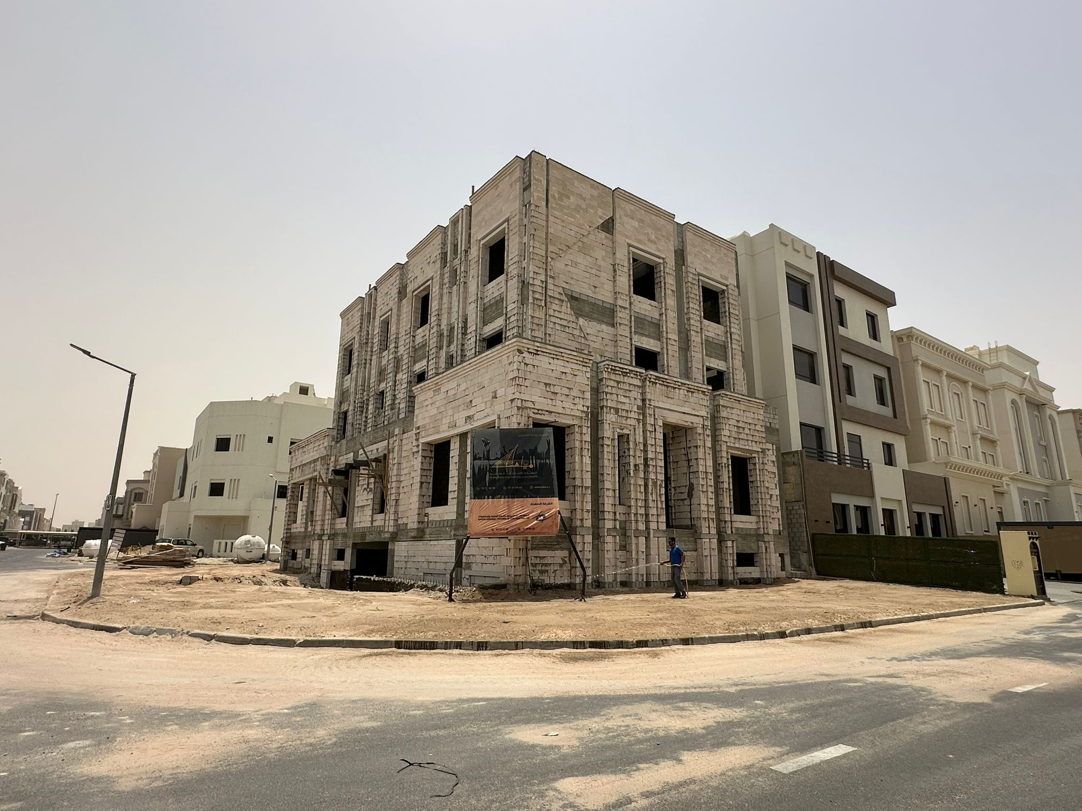
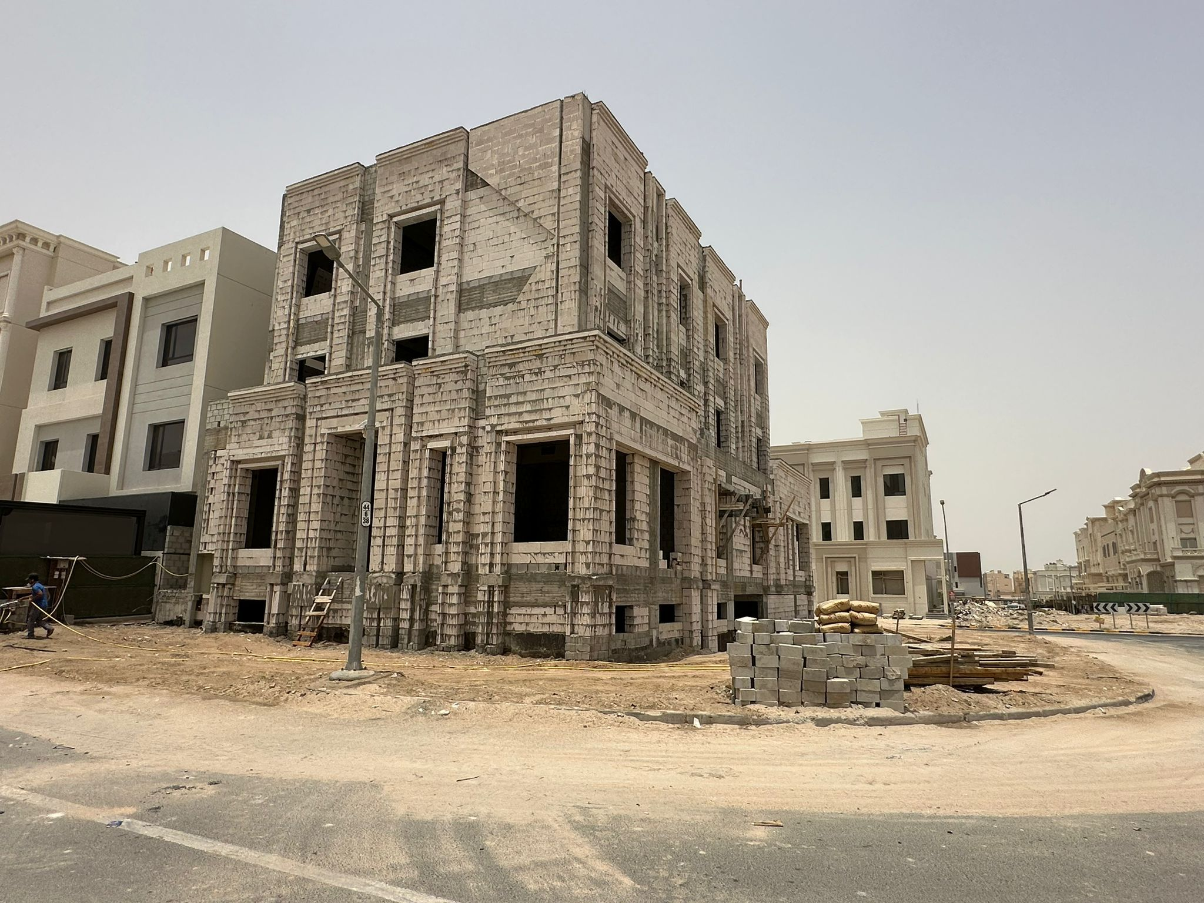
PROJECTS
Field of activities
CHAIN BUSINESS POLICY
Project Name : Connstuction of residential Villa at West Abdullah AL-Mubarak- Turn Key
Location: West Abdullah AL-Mubarak
Contrct Value: KD
Contract Duration:
2/2

Slide 15
PROJECTS
Field of activities
CHAIN BUSINESS POLICY
Project Name : Mechanical & Electrical works For 25 villa at Haya villas Project
Location:
Contrct Value: KD
Contract Duration:
Attach Photo here
2/2

